Slide 1
Parsers and Formatters

Slide 2
Information in this document is subject to change without notice. The example companies, organizations, products, people, and events depicted herein are fictitious. No association with any real company, organization, product, person or event is intended or should be inferred. Complying with all applicable copyright laws is the responsibility of the user.
Microsoft may have patents, patent applications, trademarked, copyrights, or other intellectual property rights covering subject matter in this document. Except as expressly provided in any license agreement from Microsoft, the furnishing of this document does not give you any license to these patents, trademarks, or other intellectual property.
© 2011 Microsoft Corporation. All rights reserved.
Microsoft, MS, Windows, MSDN, Visual Basic, Visual C++, Visual C#, and Visual Studio are either registered trademarks or trademarks of Microsoft Corporation in the U.S.A. and/or other countries.
Other product and company names herein may be the trademarks of their respective owners.
Microsoft Biology Initiative Training by Microsoft Corporation is licensed under a Creative Commons Attribution 3.0 Unported License. Based on a work at research.microsoft.com/bio.

Slide 3
Agenda
Built in Parsers and Formatters
Anatomy of a Sequence Parser
dealing with I/O in the .NET Framework
helper classes in .NET Bio
alphabets and Encoders
Anatomy of a Sequence Formatter
writing data back to files
Registering your parser/formatter with .NET Bio
using the Add-ins folder

Slide 4
Recap: the built-in parsers
.NET Bio has several parsers (readers) for common file formats
and support for several formatters (writers)
Sequence Formats
BED
FastA, FastQ
GenBank
GFF
Sequence Alignments
BAM
ClustalW
Nexus
SAM
Phylogenetics
Newick
PhylipParser
Sequence Formats
BED
FastA, FastQ
GenBank
GFF
Sequence Alignments
BAM
SAM
Phylogenetics
Newick
all contained in the Bio.IO namespace (or a child thereof)
Notes:
The best part of these is not just that they exist but that complete source code is available to each of them. If you truly need to build a parser or formatter then you should really look at the built-in ones and see how they are built, and what you might be able to reuse in building your implementation!

Slide 5
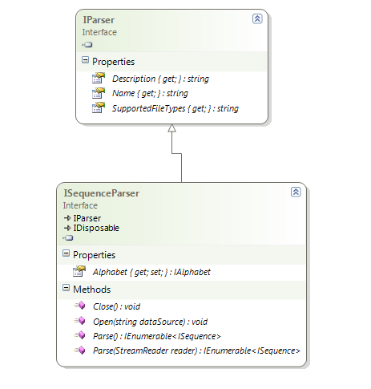
Anatomy of a Sequence Parser
Sequence Parsers should implement ISequenceParser
provides parsing consistency
oriented around files
Defines common properties
alphabet
name and description
file specification
parsing methods

Slide 6
Sequence Parsers at work
Parser translates external data into in-memory sequences
uses alphabet to validate each symbol (can be bypassed)
data.fa
>gi|186972391|gb|ACC99454.1| maturase K [Scaphosepalum rapax]
IFYEPVEILGYDNKSSLVLVKRLITRMYQQKSLISSLNDSNQN….
FastAParser
Alphabet
ISequence
73
70
89
69
.
.
.

Slide 7
Identifying a parser
IParser provides common support to identify a parser
Name should return unique, short name identifying parser^{[1]}
Description can return more descriptive identifier
partial class FastAParser : ISequenceParser
{
public string Name
{
get { return "FastA"; } }
public string Description
{
get { return "A Fasta Parser reads from a source of
text that is formatted according to the FASTA ..."; } } }
Notes:
[1] This is not enforced in .NET Bio; so you should make sure to pick a unique name – perhaps use your organization name as part of the returned string.

Slide 8
Dealing with External Data
Biology data most often comes in the form of files
convenient, portable, not tied to a platform
ISequenceParser supports parsing from a filename
includes SupportedFileTypes property to identify extensions
partial class FastAParser : ISequenceParser
{
public string SupportedFileTypes {
get { return ".fa,.mpfa,.fna,.faa,.fsa,.fas,.fasta"; } }
IEnumerable<ISequence> Parse();
... }

Slide 9
I/O in the .NET Framework
Stream class represents abstract I/O capability in .NET
concrete classes support file, network and memory storage, etc.
supports byte-array based semi-random access^{[1]}
Reader and Writer classes provide higher-level data access
take a base stream and perform binary or character translation
Text[Reader|Writer] performs character translation
Binary[Reader|Writer] performs data type translation
Writer
Reader
Stream
File handle
…
Network message
…
Memory buffer
Stream
FileStream
FileStream
MemoryStream
MemoryStream
NetworkStream
NetworkStream
unmanaged (OS) level
Notes:
[1] Assuming the underlying medium can seek into the data, the stream can support it. Sometimes the medium cannot go backwards as well – for example, once a network packet is read the prior contents are lost.

Slide 10
Programming with Streams
Stream class provides basic support to read and write data
very limited formatting capability
Stream stm = new MemoryStream();
stm.WriteByte(1);
stm.Write(new byte[] { 2,3,4 }, 0, 3);
stm.Flush();
stm.Position = 0;
int data;
while ( (data = stm.ReadByte()) != -1)
Console.WriteLine(data);
stm.Close();
Flush ensures data is written out from internal buffers to actual storage
need to reset to beginning of stream – read/write position is shared
ReadByte returns (-1) when end-of-stream is encountered

Slide 11
Using stream wrappers
TextReader and TextWriter provide abstract layer over stream
Stream[Reader|Writer] supports character formatting
Stream stm = new FileStream(
"test.txt”, FileMode.Create);
var writer = new StreamWriter(stm);
writer.WriteLine("Hello, Stream");
writer.Write(10.0);
writer.Close();
Stream stm = new FileStream(
"test.txt", FileMode.Open);
var reader = new StreamReader(stm);
string line;
while ( (line = reader.ReadLine())
!= null)
Console.WriteLine(line);
reader.Close();
supports conversion of intrinsic types into character output
treats entire file as a series of strings

Slide 12
File Streams
FileStream opens a file as a stream
can also use helpers File.OpenRead or File.OpenWrite
using System.IO;
...
partial class FastAParser : ISequenceParser
{
public IEnumerable<ISequence> Parse()
{
using (FileStream fs = File.OpenRead(filename))
{
...
}
}
}

Slide 13
Identifying a data source
Sequence parsers have two mechanisms for reading data
Open method that takes a string (filename, URL, connection, etc.)
Parse method that takes a StreamReader
You should implement both forms if data source allows for it
provides optimal flexibility to client
public IEnumerable<ISequence> Parse(StreamReader reader)
{
using (reader)
{ ... }
}
public IEnumerable<ISequence> Parse()
{
return Parse(new StreamReader(_filename));
}
Notes:
In the above example, we implement the default Parse using the parameterized version.

Slide 14
Dealing with an Alphabet
Selected alphabet determines the valid symbols
encountered symbols not in alphabet are rejected^{[1]}
Quite a bit of freedom in selecting the alphabet
parser can require it is set prior to loading the data
more likely, parser can auto-detect it or just "know" the alphabet
.NET Bio defines three common alphabet types
Alphabets.DNA (same as DnaAlphabet.Instance)
Alphabets.RNA (same as RnaAlphabet.Instance)
Alphabets.Protein (same as ProteinAlphabet.Instance)
Can define your own if necessary
necessary for custom symbols
Notes:
[1] This rejection might be as simple as ignoring the data, or it might generate an exception from the parser – it's up to the parser to decide the severity.

Slide 15
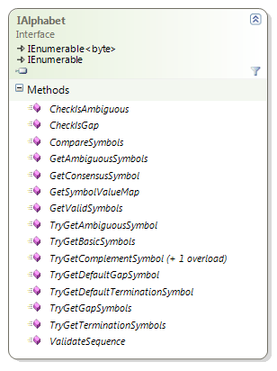
Using the default alphabets
Parsers can just hard-code the alphabet
fine if the particular format is specific to a type of data
… or can lookup the proper alphabet when parsing the file
IAlphabet.ValidateSequence method can help with this task
Decide initial alphabet to try
Call ValidateSequence passing portion of sequence .. it returns true/false if all symbols are located in the selected alphabet.
If there is no match, move onto a different alphabet to try (Alphabets.All)
bool ValidateSequence(byte[] symbols,
long offset,
long length);

Slide 16
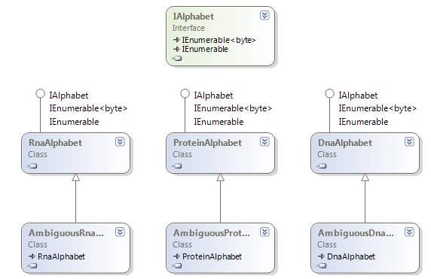
When a custom alphabet is needed
Custom alphabets implement the IAlphabet interface
currently no abstract implementation in .NET Bio
helpful to take existing implementation source and modify it
Notes:
Depending on the encoding methods used, your custom alphabets may need to recognize certain encoding schemes and provide support to translate to proper alphabet types.

Slide 17
Custom Alphabet: symbols
Alphabet should define custom symbols
partial class CustomDnaAlphabet : DnaAlphabet
{
public static CustomDnaAlphabet Instance { get; private set; }
public byte Terminator { get; private set; }
static CustomDnaAlphabet() {
Instance = new CustomDnaAlphabet(); }
protected CustomDnaAlphabet() {
Name = "Custom Dna Alphabet";
Terminator = (byte) '~';
}
...
}

Slide 18
Dealing with ambiguity
Existing alphabet implementations have AddNucleotide method
provide alternative values for symbols
partial class CustomDnaAlphabet : DnaAlphabet
{
public byte Terminator {...}
protected CustomDnaAlphabet()
{
AddNucleotide(this.Terminator, (byte)'|');
AddNucleotide(this.Terminator, (byte)'*');
...
}
...
}
Our custom alphabet will now treat '|' and '*' as the terminator symbol, but '~' is still considered the primary value

Slide 19
Custom Alphabets: methods
Should implement/override methods used for lookup
partial class CustomDnaAlphabet : DnaAlphabet
{
public override byte GetConcensusSymbol(HashSet<byte> symbols); public override bool TryGetDefaultGapSymbol(out byte gapSymbol);
...
}
Best practice is to look at the existing alphabet implementations in the source code and use one of them as the basis for your alphabet – or even derive from one of them if you have common overlapping symbols

Slide 20
Generating Sequences
Parsers return ISequence objects
can create your own, but easiest to use Sequence type
alphabet and byte data required to create
private ISequence CreateSequence(byte[] data)
{
Sequence sequence = new Sequence(Alphabet, data, false);
return sequence;
}
optional flag indicates whether alphabet should validate symbols during construction – often want this to be turned off as you have already validated them during the load process
Notes:
[1] Best practice is to make it read-only by default.

Slide 21
Returning sequences from Parse
Parse returns IEnumerable<ISequence>
allows for "lazy-loading" of sequence data if format permits
use C# iterator feature yield return
public IEnumerable<ISequence> Parse()
{
using (FileStream fs = File.OpenRead(filename))
{
ISequence sequence = ParseOneFromFile(fs);
yield return sequence;
} }
The above code looks simple enough but actually generates a state machine – each yield return actually supplies one sequence for the IEnumerable and if the consumer does not read all of the sequences we do not parse all the data
Notes:
This design has some interesting ramifications for usage. For example, many parsers can only call Parse once – once it's parsed you need to dispose the parser and re-open it to re-parse the data.

Slide 22
Summary: building a parser
Implement ISequenceParser
decide on name and description of the parser
decide on proper alphabet (or auto-detect)
create a Sequence for each read sequence
return sequence(s) using IEnumerable<ISequence>

Slide 23
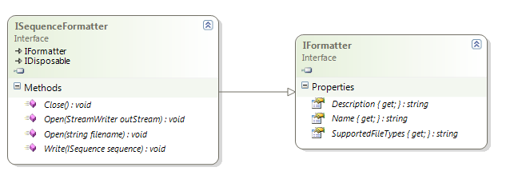
Writing sequences back out
Formatters take in-memory sequences and write out data
less common than parsers, but fully supported by .NET Bio
much simpler to implement in general
Base required interface used is ISequenceFormatter
formatter pushes ISequence data out to file-based storage

Slide 24
Writing sequence data
Writing the sequence data out involves
taking the byte values from each written ISequence
writing them to the file with the proper structure
public void Write(ISequence sequence)
{
writer.WriteLine(":" + sequence.ID + ":");
writer.WriteLine(GenerateStringFromBytes(sequence));
writer.Flush();
}
:Scaphosepalum rapax:
IFYEPVEILGYDNKSSLVLVKRLITRMYQQKSLISSLNDSNQN….
sample format writes out ID on one line and entire sequence on the next

Slide 25
Integrating with .NET Bio
Programs can consume custom formatters and parsers
simply instantiate the classes directly
Alternatively, developers can expose their classes as add-ins
allows alphabets, parsers, formatters and algorithms to be added dynamically to .NET Bio collections
var parser = new MyParser();
var parser = SequenceParsers.All.FirstOrDefault(sp =>
sp.SupportedFileTypes.Contains(
Path.GetExtension(filename)));
in this second case, we can lookup the parser using the file extension – we don't have to know exactly which one it should be as long as it exposes SupportedFileTypes properly!
Notes:
The primary reason why you want to expose your classes as add-ins is they become dynamically discoverable – i.e. existing programs such as the Excel add-in and sequence assembler will see your parsers without being recompiled or changed to support them. It provides reuse without change and hides the implementation away.

Slide 26


Steps to using add-ins
Place your parser / formatter into separate assembly
Decorate parser / formatter class with RegistrableAttribute
Copy the assembly into a "Add-ins" sub-directory
1
Company.IOAddin.dll
2
[Registrable(true)]
public class MyParser : ISequenceParser {...}
[Registrable(true)]
public class MyFormatter : ISequenceFormatter {...}
3

Slide 27
Summary
.NET Bio was designed to be extended with new file formats
supports custom parsers to read data
supports custom formatters to write data
Parser must decide proper alphabet
can create custom alphabets if necessary
Formatter less common, but easily creatable
Useful to add types into .NET Bio lists through add-in support
just apply attribute and move assembly to proper location

Slide 28
Disclaimer: This document is provided "as-is". Information and views expressed in this document, including URL and other Internet Web site references, may change without notice. You bear the risk of using it.
This document does not provide you with any legal rights to any intellectual property in any Microsoft product. You may copy and use this document for your internal, reference purposes.
© 2011 Microsoft Corporation. All rights reserved.
Microsoft, Visual Studio, and Windows are trademarks of the Microsoft group of companies. All other trademarks are property of their respective owners.

